Slide 1
Calculation of market risk measures in Mexico’s International Reserve portfolio
Christian Carmona
UC Berkeley Risk Seminar
February 2014

Slide 2
Disclaimer
The material in this presentation has been prepared by Christian Carmona and it contains only publicly available data.
The views and opinions presented here are are those of the author and do not necessarily reflect the official policy or position of the Central Bank of Mexico (Banxico). The methodology presented here does not necessarily meet official methodologies adopted by the institution.

Slide 3
Agenda
International Reserves
Definition and objectives
Size of international reserves
Composition of International reserves
Reserve Management Guidelines (FMI)
Central Bank of Mexico Guidelines
Market Risk for Mexico’s international reserves
Sources of calculation
RIskMetrics methodology
Model Assumptions
Valuation
R library: port_mc_var
Description
Definition of input and some examples of output
Backtesting
Live example

Slide 4
International Reserves
Definition
International Reserves consist of those external assets that are readily available to and controlled by a country’s authorities for direct financing of international payments imbalances, for indirect regulation of the magnitude of such imbalances through intervention in foreign exchange markets to affect their currency’s exchange rate, and for other purposes.
The category of reserve assets defined in the IMF Balance of Payments Manual comprises monetary gold, special drawing rights (SDRs), reserve position in the IMF, foreign exchange assets (consisting of currency, and deposits and securities), and other claims.
Purpose
Typically, official foreign exchange reserves are held in support of a range of objectives, including to:
Support and maintain confidence in the policies for monetary and exchange rate management, including the capacity to intervene in support of the national or union currency;
Limit external vulnerability by maintaining foreign currency liquidity to absorb shocks during times of crisis or when access to borrowing is curtailed, and, in doing so;
Provide a level of confidence to markets that a country can meet its current and future external obligations;
Demonstrate the backing of domestic currency by external assets; assist the government in meeting its foreign exchange needs and external debt obligations; and
Maintain a reserve for national disasters or emergencies.

Slide 5
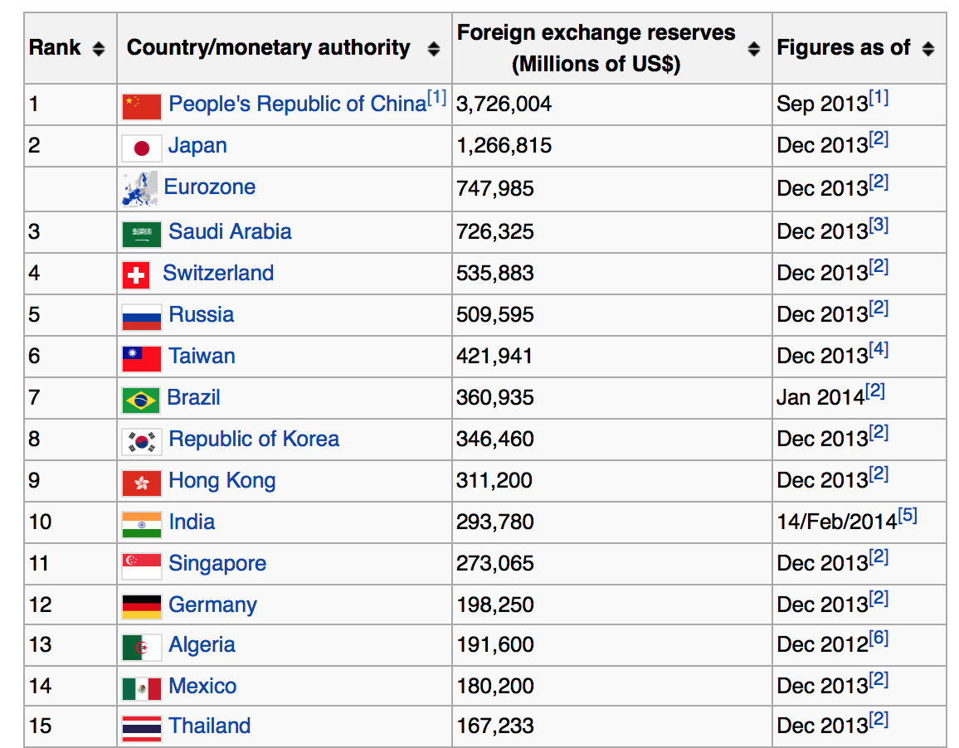
International Reserves

Slide 6
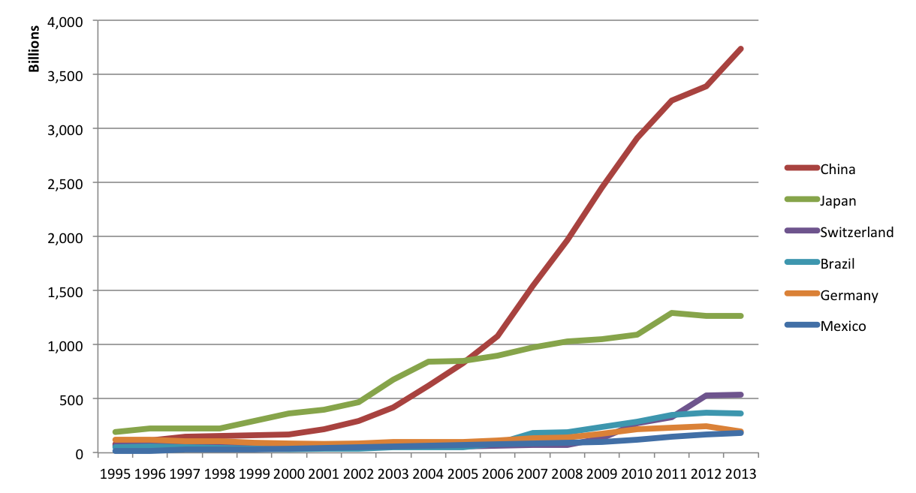
International Reserves
International reserves market value
(USD Billions)
Source: The World Bank
http://data.worldbank.org/indicator/FI.RES.TOTL.CD

Slide 7
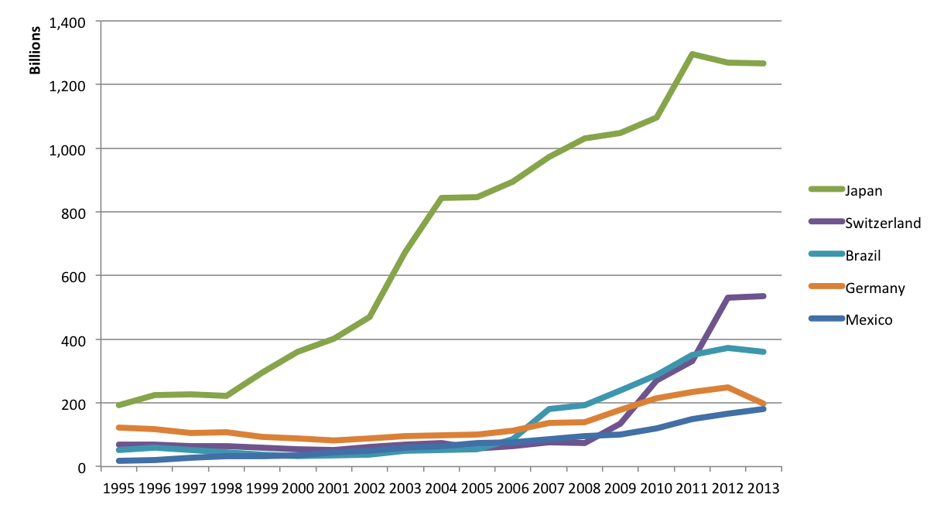
International Reserves
International reserves market value
(USD Billions)
Source: The World Bank
http://data.worldbank.org/indicator/FI.RES.TOTL.CD

Slide 8
International Reserves Composition
International reserves portfolios are typically composed by a mixture of financial instruments in several currencies.
Bank deposits.
Currency forward contracts.
Short- and long-term fixed-income securities in different currencies
Sovereign Bonds
Government agencies bonds
Government-sponsored enterprises bonds
Gold
Options in Currencies and Gold
IMF’s SDR (Special Drawing Rights)
(IMF’s Currency Composition of Official Currency Exchange Reserves database:
http://www.imf.org/External/np/sta/cofer/eng/index.htm)

Slide 9
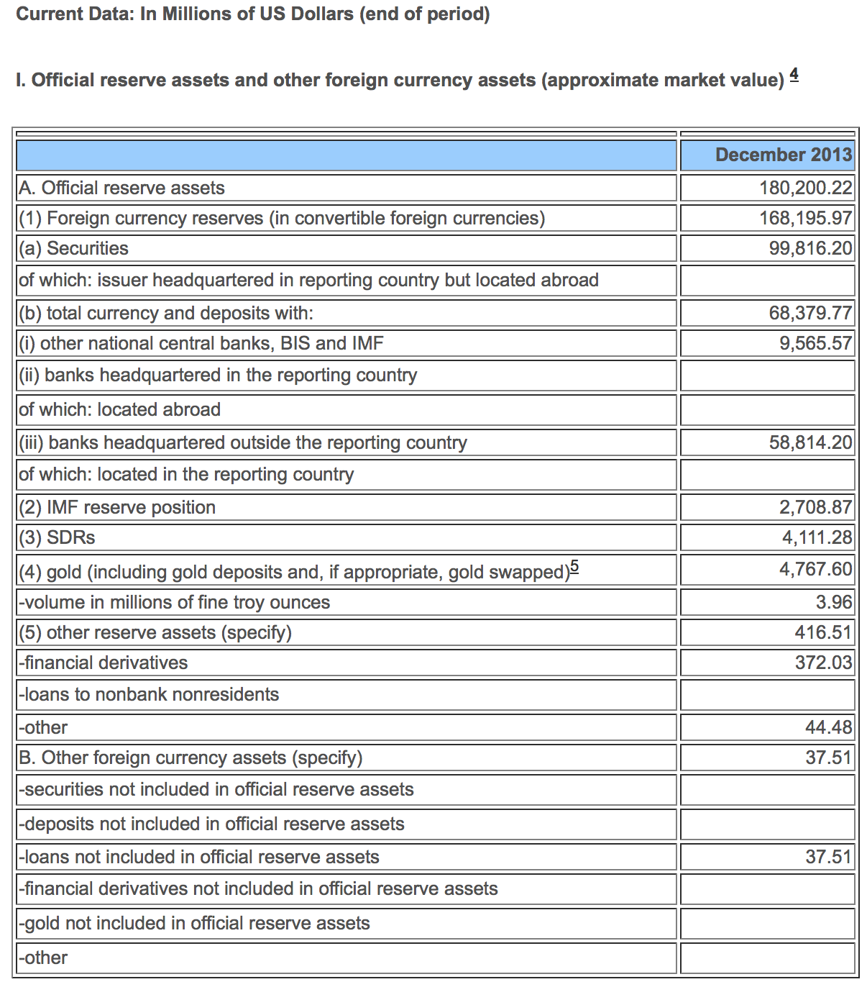
International Reserves Composition MEXICO
Source: International Monetary Fund
http://www.imf.org/external/np/sta/ir/IRProcessWeb/data/mex/eng/curmex.htm

Slide 10
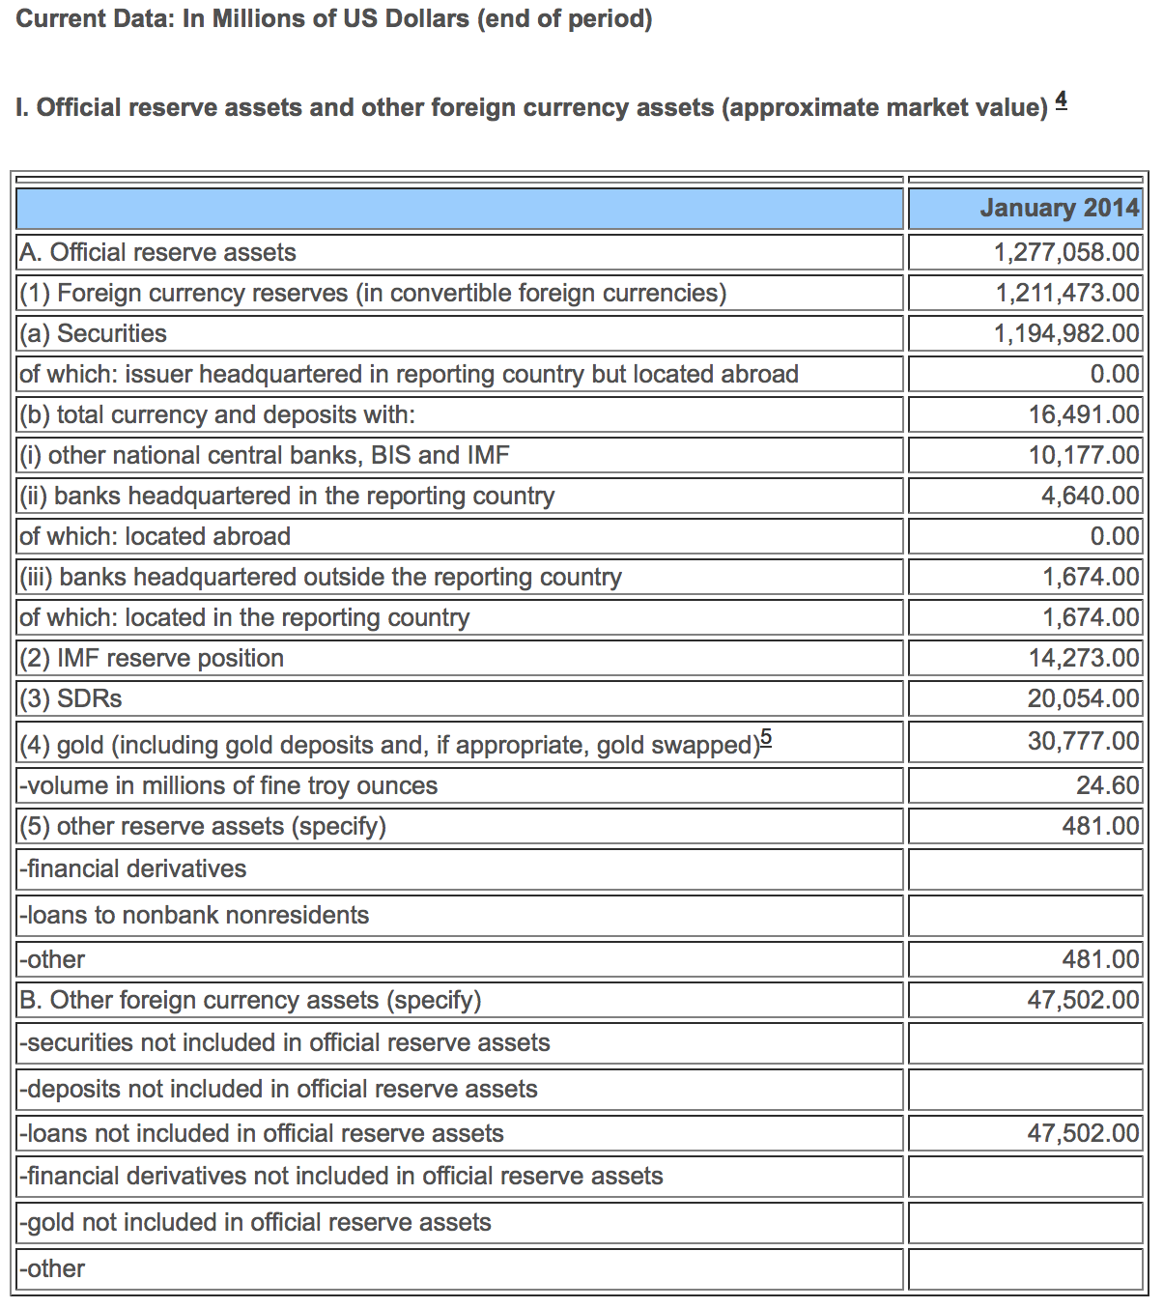
International Reserves Composition JAPAN
Source: International Monetary Fund
http://www.imf.org/external/np/sta/ir/IRProcessWeb/data/jpn/eng/curjpn.htm

Slide 11
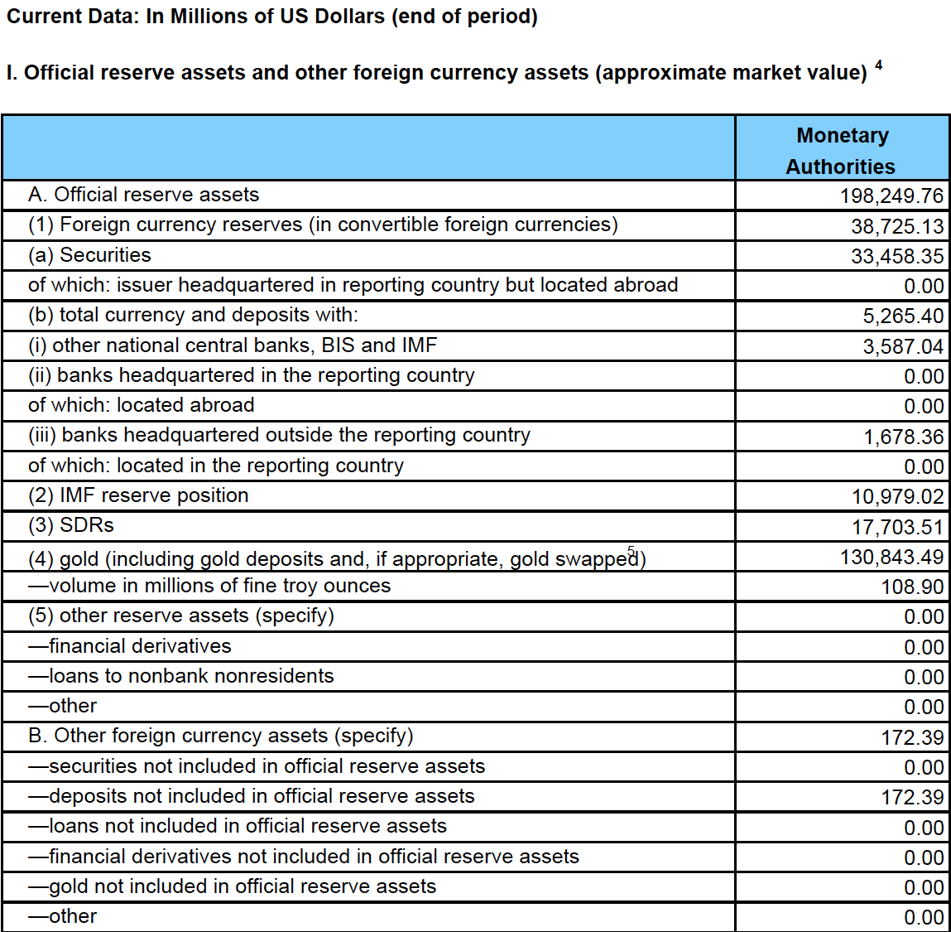
International Reserves Composition GERMANY
Source: International Monetary Fund
http://www.imf.org/external/np/sta/ir/IRProcessWeb/data/deu/eng/curdeu.pdf

Slide 12
International Reserves Portfolio management*
Appropriate portfolio management policies concerning the currency composition, choice of investment instruments, degree of credit risk exposure, and acceptable duration of the reserves portfolio should reflect a country’s specific policy settings and circumstances and ensure that assets are safeguarded, readily available, and support market confidence.
Reserve management should seek to ensure that:
Adequate foreign exchange reserves are available for meeting a defined range of objectives
Liquidity, market, credit, legal, settlement, custodial, and operational risks are controlled in a prudent manner
Subject to liquidity and other risk constraints, reasonable risk-adjusted returns are generated over the medium to long term on the funds invested.
*IMF: Guidelines for foreign exchange reserve management
https://www.imf.org/external/np/mae/ferm/eng/

Slide 13
Mexico’s International Reserve Reserve management
In the case of Mexico, several policies for reserve management are implemented in practice. These are specified and published through an internal (non-public) document approved by the board of government
Main policies include:
Definition of roles and responsibilities for operational duties by office.
Portfolio definition:
Instrument types allowed for investment
Portfolio’s benchmark definition
Allocation by intrument type
Standards for portfolio rebalancing
Standards for pricing and valuation
Risk management
Credit risk:
Bank deposit allocation limits according to credit rating
Bonds have to satisfy a minimum credit rating to be allowed for investment
Market risk:
A maximum level of VaR as a percentage of portfolio’s market value
A maximum level of VaR in the deviation portfolio.
A maximum tolerated cumulative loss for deviations from Benchmark
Liquidity risk
A required minimum percentage of the portfolio investment has to satisfy liquidity conditions

Slide 14
Market risk measurement
Different Sources:
Custodian
JPMorgan
Only provide reports specified in the custodian contract
Slow response in specific queries
Purchased software
Openlink’s FINDUR
Black box software
Difficult to configure new instruments
Only provides aggregated VaR, not by instruments
Not a risk management software
Barclay’s Point
Black box software
Difficult to introduce our pricing standards
Very expensive
In-house
R package: port_mc_var

Slide 15
Market risk measurement Model specification
JPMorgan’s Risk Metrics methodology* **:
Instruments market risk can be assessed by stressing only a few risk factors.
In the case of our portfolio, these risk factors include:
Currencies and commodities
Spot-rate curves (zero-coupon)
US govt (1m,3m,6m,1y,5y,15y,30y)
US agencies
CAN govt
CAN agencies
Gofo rates
A methodology for portfolio’s exposure identification is specified.
The exposures are priced using a factor-based valuation under current prices and simulated scenarios.
The distribution on the profit and losses under the simulated scenarios will give us the details of the potential losses
*J.P. Morgan. RiskMetrics: Technical Document, Fourth Edition. 1996
**Riskmetrics Group. Return to RiskMetrics: The evolution of a Standard. 2001

Slide 16
Market risk measurement Calculation process
Portfolio specification
Load instruments information
Identification of risk factors
Identify portfolio’s exposure
Obtain historical information
Portfolio valuation with current prices
Estimation of model parameters:
E(R_{i}), Cov_{t}(R_{i},R_{j})
Simulation of risk factors
Portfolio valuation under simulated scenarios
Profit & Losses
Distribution
Market Risk Measures:
VaR , CVaR

Slide 17
Market risk measurement Model specification
Risk factors:
Factors driving the prices of financial securities are equity prices, foreign exchange rates, commodity prices, and interest rates.
Equity
An equity exposure can be represented by its own time series of prices, or alternatively, mapped to an appropriate index.
Foreign exchange:
Spot exchange rates drive the currency risk of cash positions in foreign currencies, FX forwards, cross currency swap.
Commodities:
Commodity exposures are driven by spot and future prices.
Fixed-Income instruments:
The drivers of fixed income exposures can be expressed as zero-coupon bonds with maturities ranging in the whole yield curve.
In the case of fixed income instruments denominated in a foreign currency, the exchange rate also has to be taken into account

Slide 18
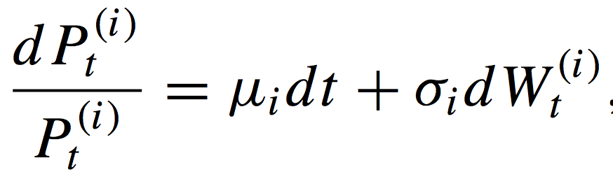
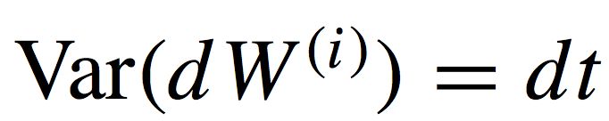

Market risk measurement Model specification
RiskMetrics model of risk factor returns: A modified random walk
RiskMetrics methodology assumes that logarithmic returns on the risk factors follow a multivariate normal distribution conditional on dynamic volatility and covariances.
Suppose that we have n risk factors
Then, the process generating the changes for the i-th risk factor can be written as:
with

Slide 19
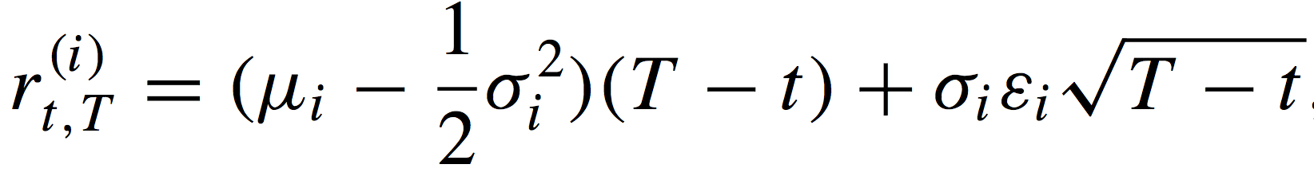
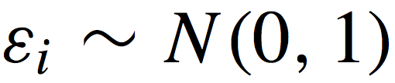
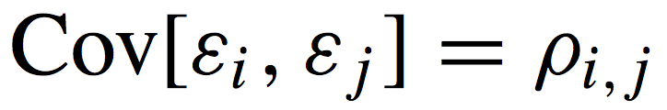
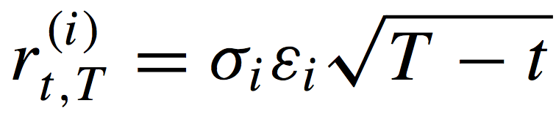
Market risk measurement Model specification
It follows that the return on each asset from time t to time t+T can be written as:
where
If we incorporate the zero mean assumption we get that

Slide 20
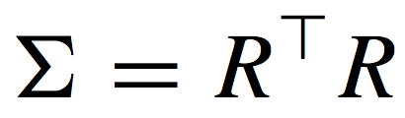
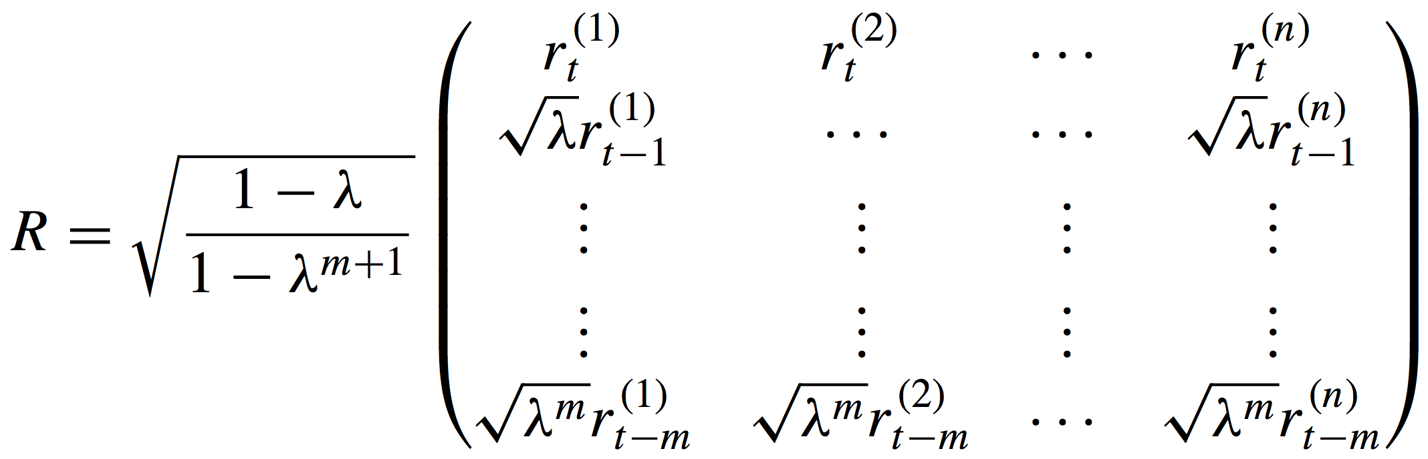
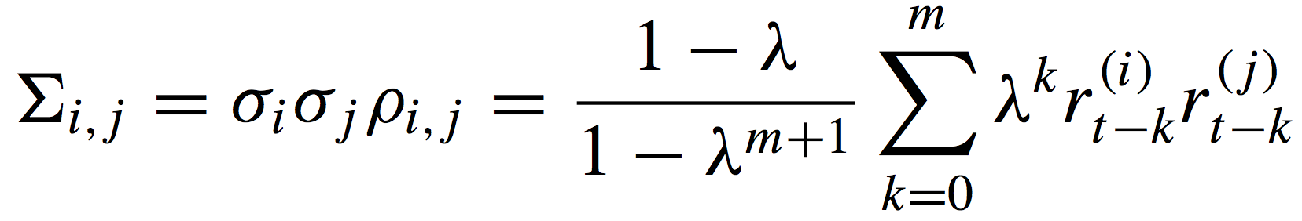
Market risk measurement Model specification
Covariance matrix estimation:
RiskMetric model estimates the covariance of risk factors using an Exponential Weighted Moving Average (EWMA).
equivalent:

Slide 21
Market risk measurement Model specification
Monte Carlo simulation
The Monte Carlo simulation consists of three major steps:
1. Scenario generation:
Using the volatility and correlation estimates for the underlying assets in our portfolio, we produce a large number of future price scenarios in accordance with the lognormal model for prices.
2. Portfolio valuation
For each scenario, we compute a portfolio value.
3. Summary
We report the results of the simulation, either as a portfolio distribution or as a particular risk measure.

Slide 22
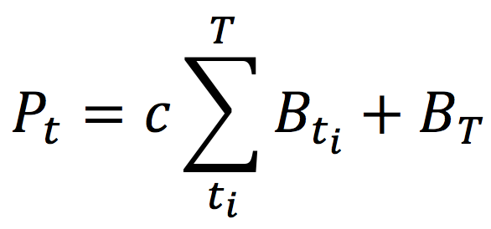
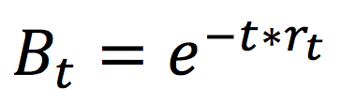
Market risk measurement Model specification
Exposures identification and valuation
Fixed-Income instruments:
Bond prices are stressed with its corresponding yield curve
The price is the present value of its cash flows given a specified zero coupon curve
with:
the price of a zero-coupon bond maturing in t years
The value of zero-coupon rates can be obtained using bootstrap method to transform observed yield to maturity market quotes. Using this method also require us to use interpolation for getting yield rates in terms where no bond prices are observed in the market
Spot positions in currencies and commodities
The risk exposure of these positions are function of the exchange rate.
Fixed-income instruments denominated in foreign exchange are also under the effect of this factor.

Slide 23
Market risk measurement Software implementation
The methodology was implemented in a library for the statistical software R and has being used as a source for market risk assessment and analysis of risk attribution in the Risk Management Division of the Central Bank of Mexico.
R Package: port_mc_var
The library consists of a set of objects, classes, methods and functions that go through the process of market risk calculation for a given specified portfolio.
Each required step in this process is performed by a different and independent function. This modular nature of the library allow the user to change/improve any given part of the process and preserve the functionality of the remaining parts (example: Simulation by bootstrap instead of Gaussian model)
The functions created to gather the required information can create files that are Bloomberg-friendly and fill the required data in an automatized fashion. However, even in the absence of a Bloomberg terminal, users can easily fill the data thanks to the simplified .csv format of the input files.
The output of the process is a simulated distribution of profit and losses for each position in the portfolio. This enable the user to aggregate instruments by type, maturity, currency, etc. and perform risk attribution analysis.

Slide 24
Market risk measurement Calculation process
Portfolio specification
Load instruments information
Identification of risk factors
Identify portfolio’s exposure
Obtain historical information
Portfolio valuation with current prices
Estimation of model parameters:
E(R_{i}), Cov_{t}(R_{i},R_{j})
Simulation of risk factors
Portfolio valuation under simulated scenarios
Profit & Losses
Distribution
Market Risk Measures:
VaR , CVaR

Slide 25
Market risk measurement Calculation process
User
load_portfolio( )
load_gdb_port( )
[[“instr_info”]]
Bloomberg
load_gdb_port( )
[[“curves_info”]]
User
Bloomberg
load_gdb_port( )
[[“cshf_info”]]
Bloomberg
load_hist_factor( port )
port_valuation_byfactors(
port, fact_hist )
zero_from_yield( )
logrtn( fact_hist )
ewma_cov( fact_rtn )
sim_factor( cov , fact_hist )
port_valuation_byfactors(
port, fact_sim )
market_risk_calc()
report_var_port( )

Slide 26
Market risk measurement Software implementation
Input
Portfolio:
.csv file with two columns, specifying instrument and position. One row for each position
Global databases:
Instruments information:
.csv file with the information regarding all known instruments, such as type of instrument, maturity, issuer, coupon rate, ISIN, currency etc.
it also specifies what curve/factor should be used for stressing the instrument
Cash flows information:
.csv file specifing the date and amount for the cashflows paid by bonds. 3 column
Risk factors information:
.csv file with the details for each risk factor, such as bloomberg ticker, curve type and exchange standard
Historical data for risk factors:
.csv file with the historical values for all risk factors.

Slide 27
Market risk measurement Software implementation
Output
R objects:
Estimated covariance matrix
Risk factor simulated scenarios
Portfolio valuation (factor-based valuation)
with current factors
with simulated factors
Profit and Losses density estimation
Value at risk (customizable confidence levels)
global portfolio
by instrument type
by time to maturity
by individual instrument
Reports (files):
.pdf with non-parametric estimation of the P&L distribution.
.csv file report with VaR

Slide 28
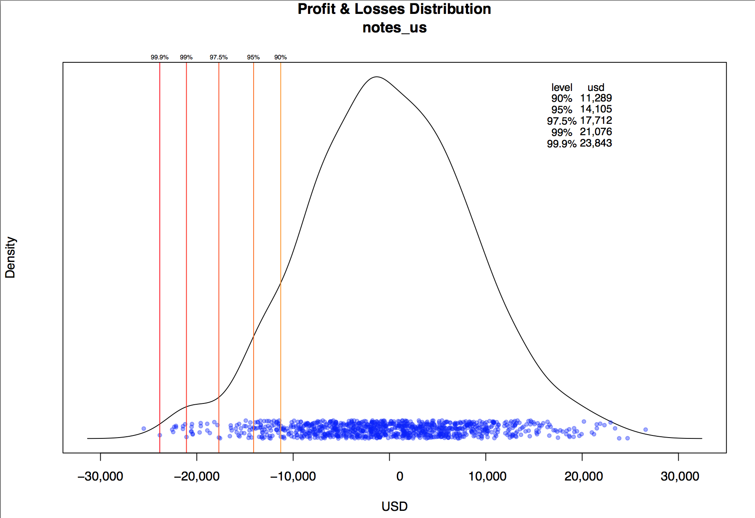
Market risk measurement Software implementation

Slide 29
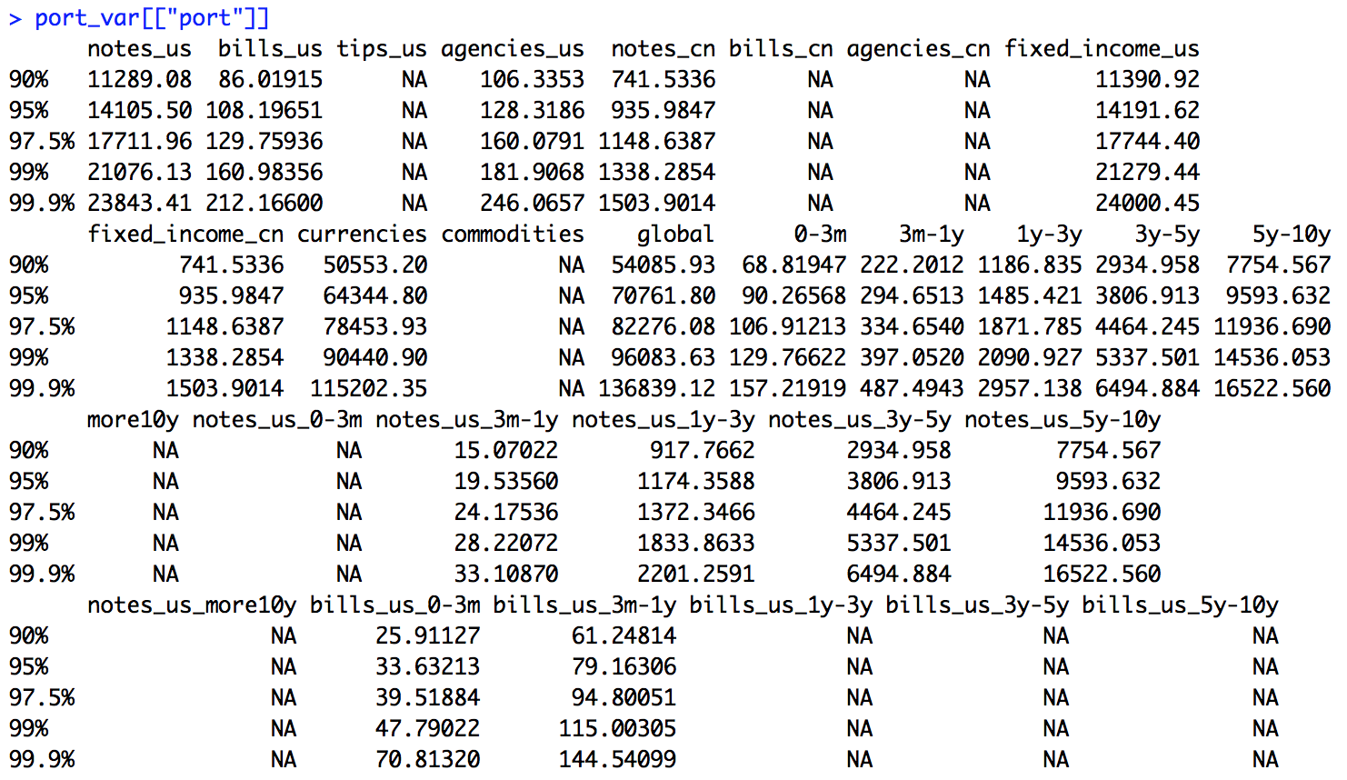
Market risk measurement Software implementation

Slide 30
Market risk measurement Back testing 2013
In order to measure the performance of this software, I did the following analysis:
Created a Portfolio incluiding fixed-income securities and currency deposits according to the following table:
Rebalancing the portfolio once each month
Calculate the daily market value for the portfolio and obtain the real profit and losses with observed market prices (full valuation, no factor-based valuation).
Calculate the daily Value at Risk for the aggregated portfolio and for each separated subportfolio specified in the table above.
Calculation from Jan 01, 2013 to Dec 31, 2013
Instrument type | Number of securities* | weighting (%)
US Treasury Bills | 30 | 10.04
US Treasury Notes 1-5 years | 150 | 38.65
US Treasury Notes 5-10 years | 130 | 21.12
US Agencies 1-3 years | 60 | 2.63
CA Govt. Notes 0-3 years | 20 | 1.79
Euro (EUR) | 1 | 11.54
Sterling Pound (GBP) | 1 | 14.22

Slide 31
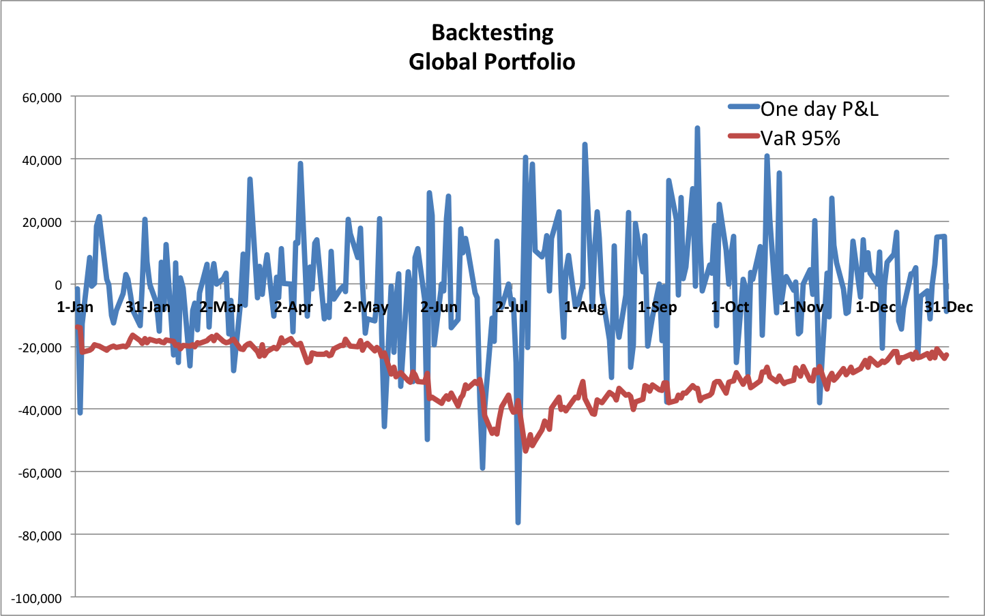
Market risk measurement Back testing 2013
Losses exceding VaR:
5.385%

Slide 32
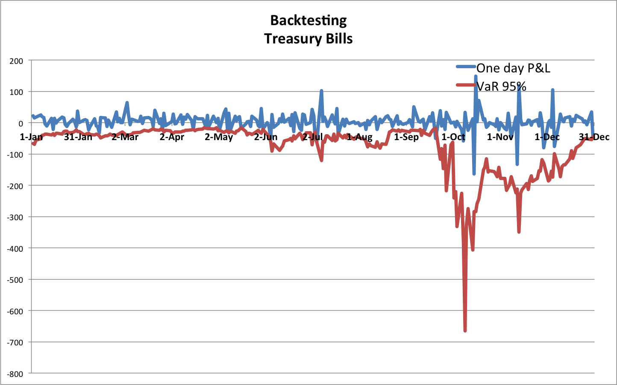
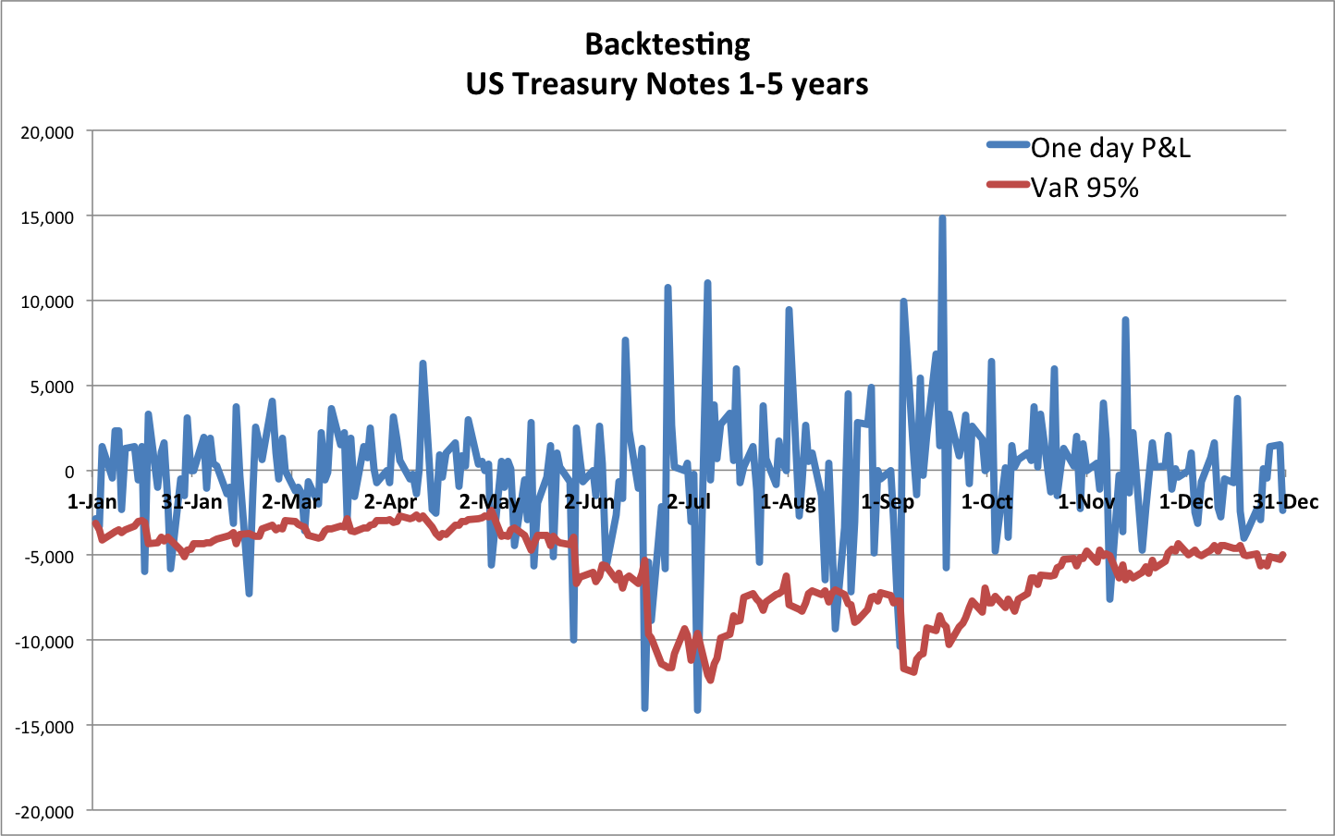
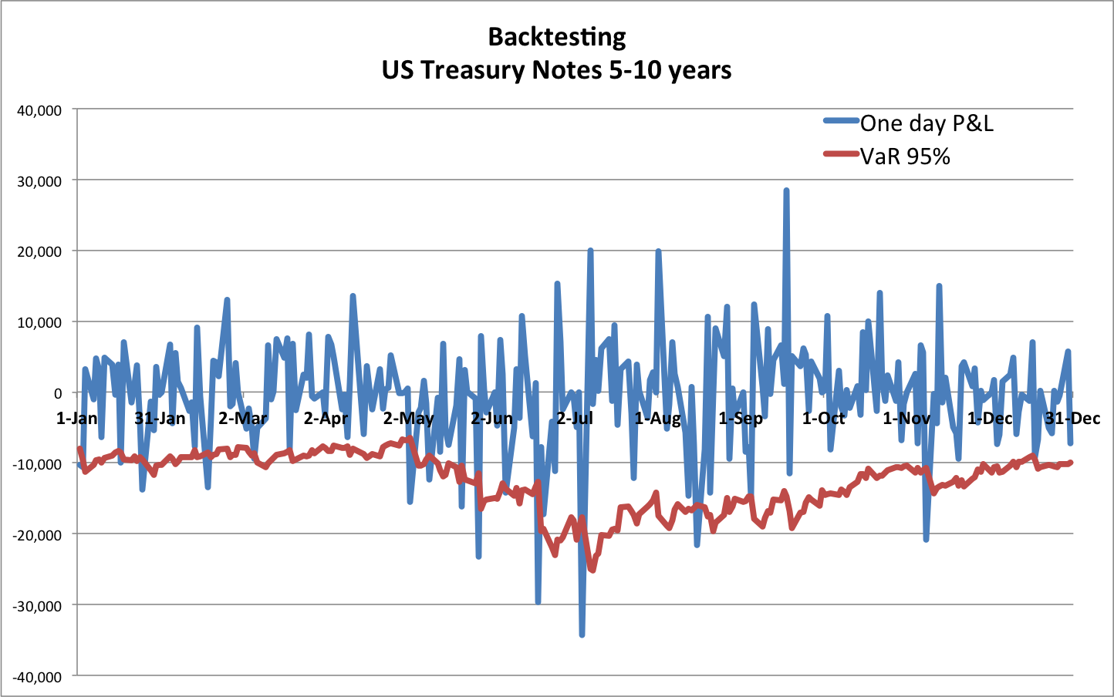
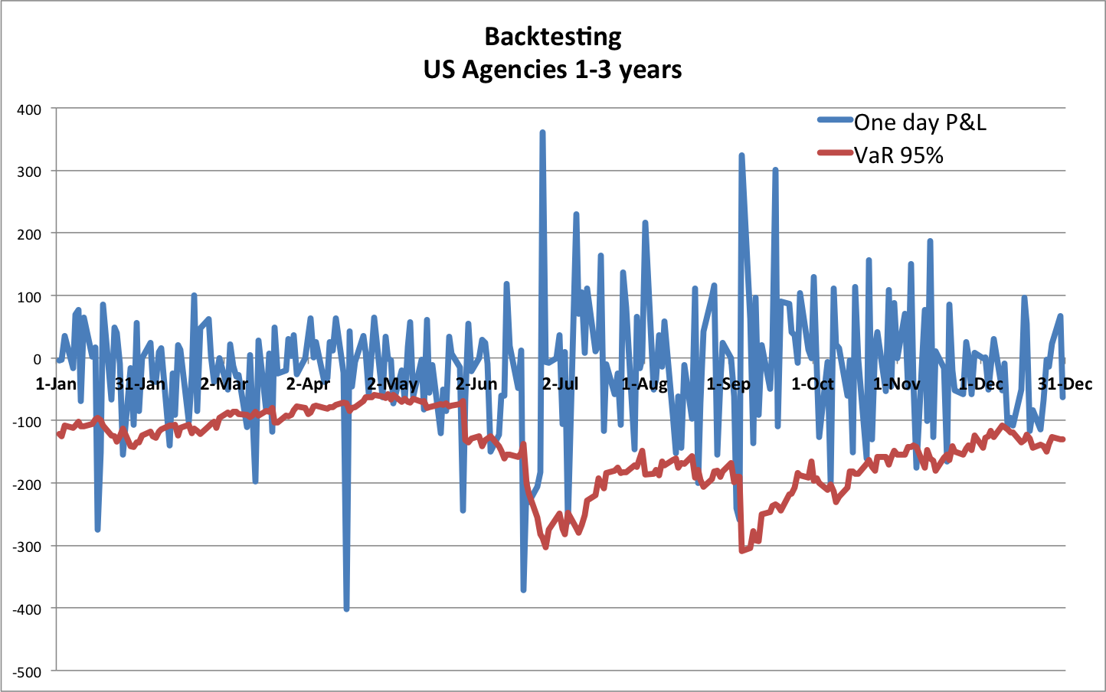
Market risk measurement Back testing 2013
Losses exceding VaR:
2.31%
Losses exceding VaR:
5.77%
Losses exceding VaR:
6.15%
Losses exceding VaR:
9.23%

Slide 33
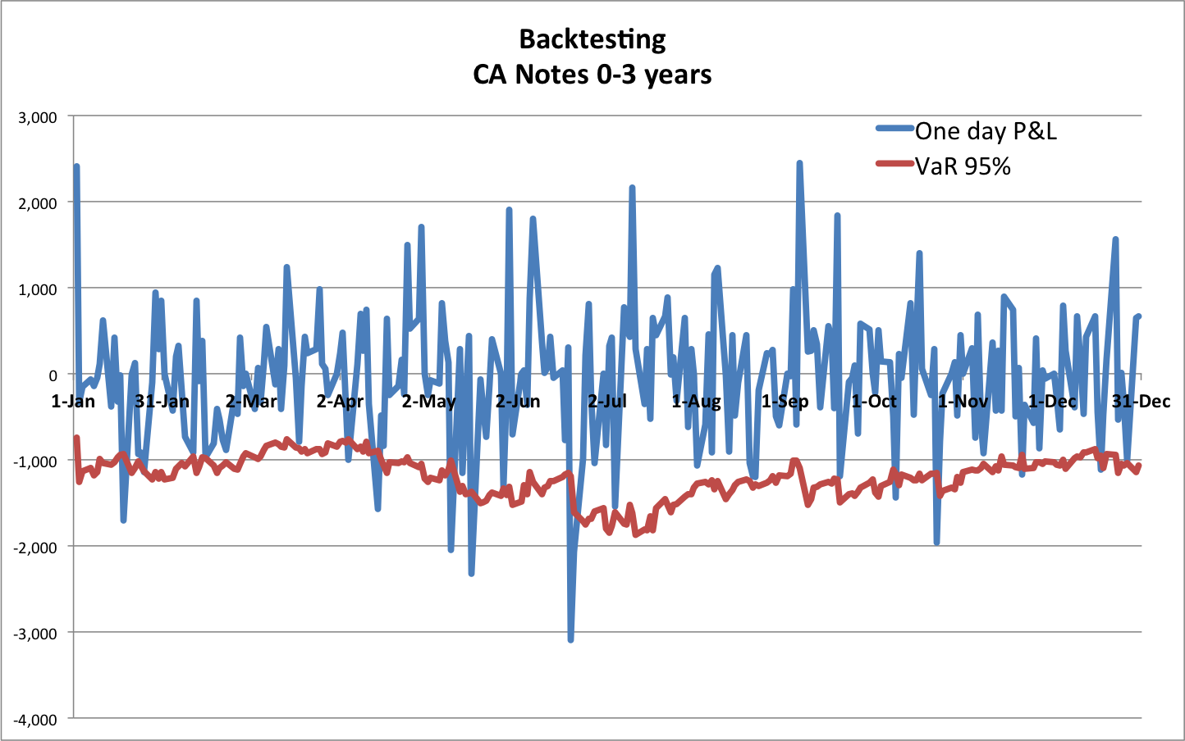
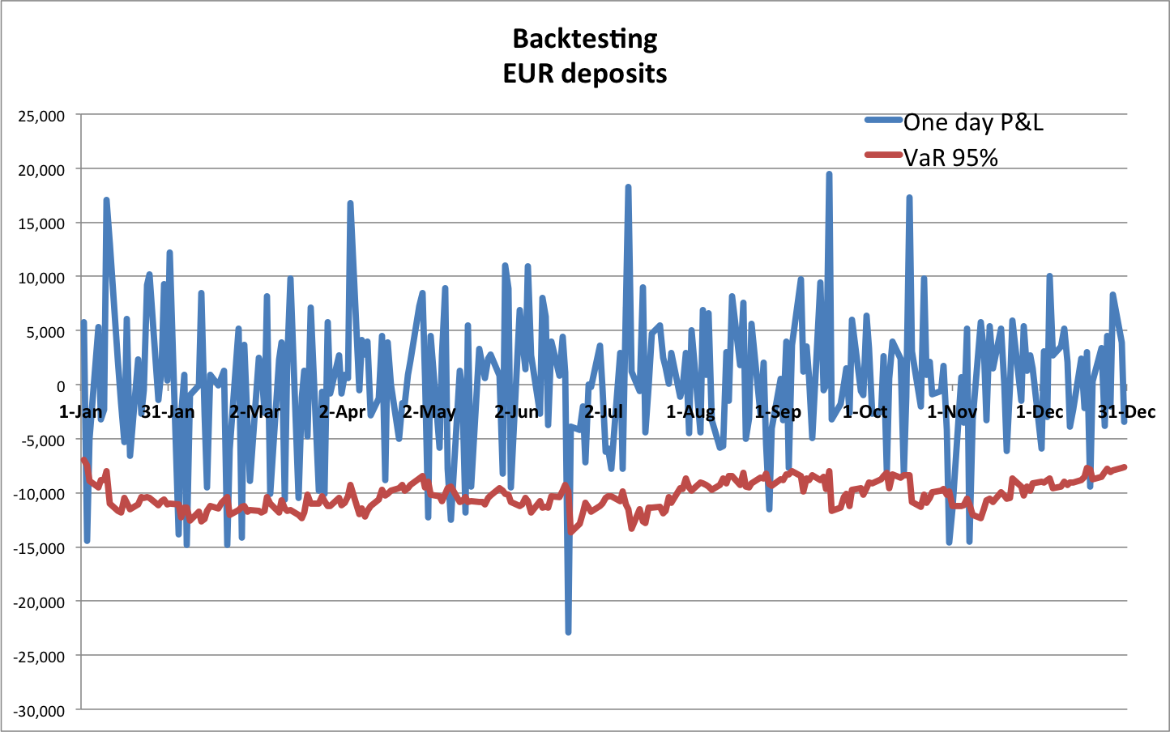
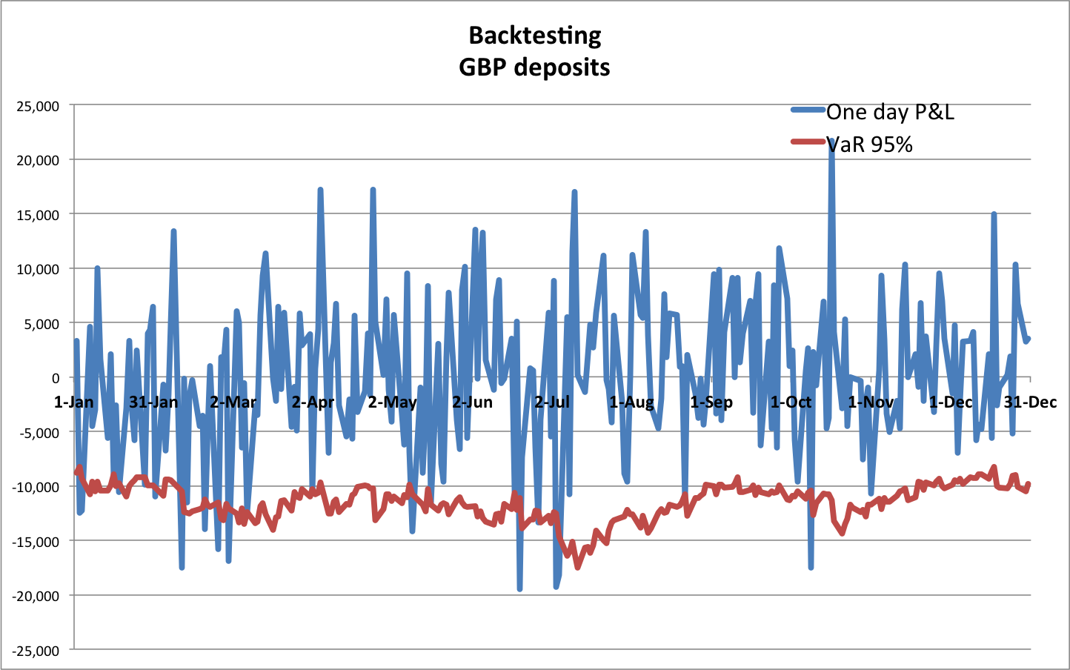
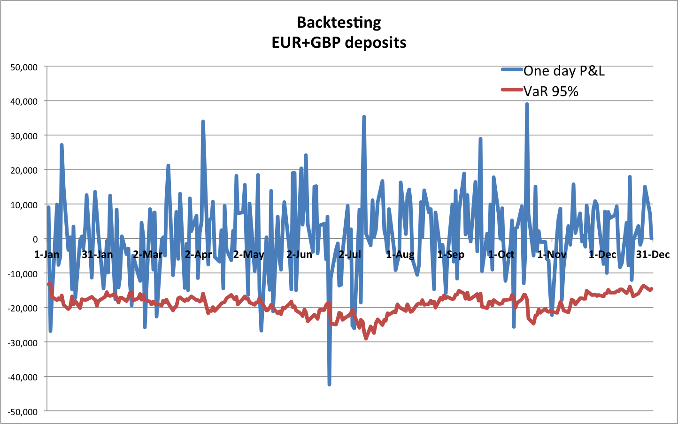
Market risk measurement Back testing 2013
Losses exceding VaR:
4.62 %
Losses exceding VaR:
5.38%
Losses exceding VaR:
7.31%
Losses exceding VaR:
5.01%

Slide 34
Market risk measurement Development
Areas of development
Assumptions to stress volatility
Fancier models for modeling scenarios
Incorporate curve correction: to fully match real bond prices with factor-based valuation in base scenario

